Slide 1



Splash Screen

Slide 2
Lesson Menu
Then/Now
New Vocabulary
Key Concept: Quadratic Formula
Example 1: Two Rational Roots
Example 2: One Rational Root
Example 3: Irrational Roots
Example 4: Complex Roots
Key Concept: Discriminant
Example 5: Describe Roots
Concept Summary: Solving Quadratic Equations

Slide 3


Then/Now
You solved equation by completing the square. (Lesson 5–5)
Solve quadratic equations by using the Quadratic Formula.
Use the discriminant to determine the number and type of roots of a quadratic equation.

Slide 4


Vocabulary
Quadratic Formula
discriminant

Slide 5
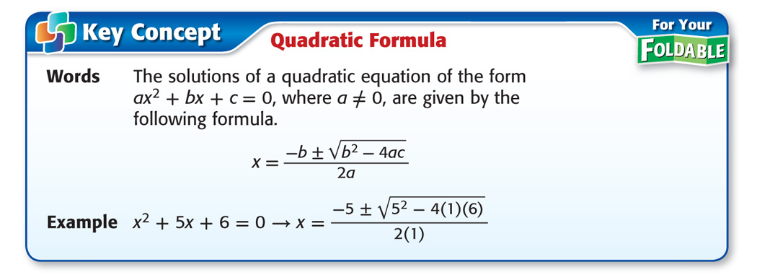
Concept

Slide 6
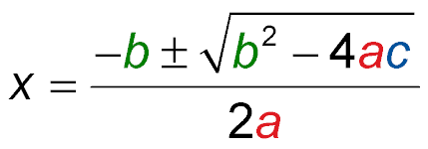
Example 1
Two Rational Roots
Solve x² – 8x = 33 by using the Quadratic Formula.
First, write the equation in the form ax² + bx + c = 0 and identify a, b, and c.
ax² + bx + c = 0
x² – 8x = 33 1x² – 8x – 33 = 0
Then, substitute these values into the Quadratic Formula.
Quadratic Formula

Slide 7
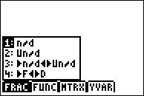
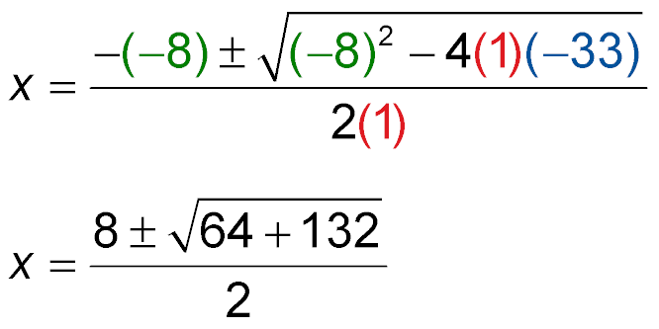
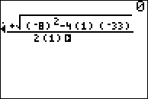
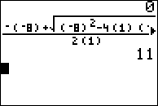
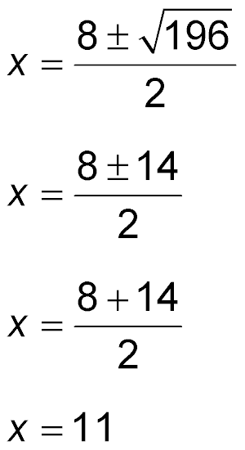
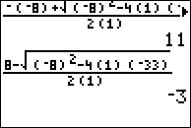

Example 1
Two Rational Roots
Replace a with 1,
b with –8, and c
with –33.
The calculator
does not do
plus or minus
so you have
to enter the
expression twice,
once with + and
once with -.
Simplify.
Simplify.

Slide 8
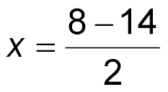
Example 1
Two Rational Roots
or Write as two equations.
x = 11 x = –3 Simplify.
Answer: The solutions are 11 and –3.

Slide 9


Example 1
Solve x² + 13x = 30 by using the Quadratic Formula.
A. 15, –2
B. 2, –15
C. 5, –6
D. –5, 6
A
B
C
D

Slide 10
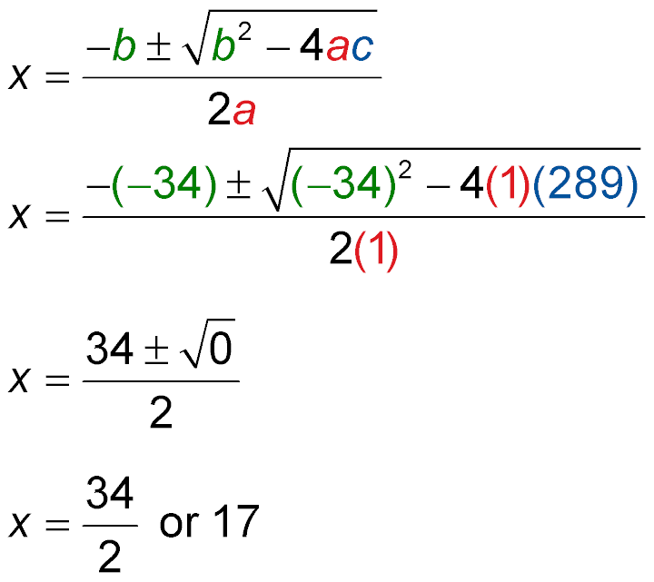
Example 2
One Rational Root
Solve x² – 34x + 289 = 0 by using the Quadratic Formula.
Identify a, b, and c. Then, substitute these values into the Quadratic Formula.
Quadratic Formula
Replace a with 1, b with –34, and c with 289.
Simplify.

Slide 11

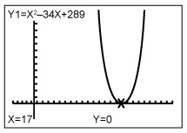
Example 2
One Rational Root
Answer: The solution is 17.
Check A graph of the related function shows that there is one solution at x = 17.
[–5, 25] scl: 1 by [–5, 15] scl: 1

Slide 12
Example 2
Solve x² – 22x + 121 = 0 by using the Quadratic Formula.
A. 11
B. –11, 11
C. –11
D. 22
A
B
C
D

Slide 13
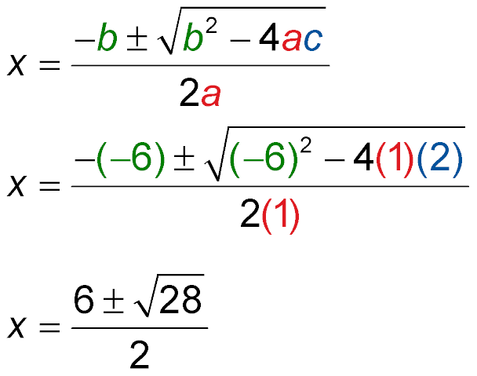
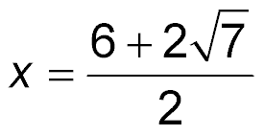
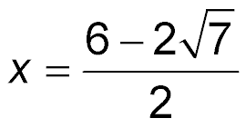


Example 3
Irrational Roots
Solve x² – 6x + 2 = 0 by using the Quadratic Formula.
Quadratic Formula
Replace a with 1, b with –6, and c with 2.
Simplify.
or
or

Slide 14
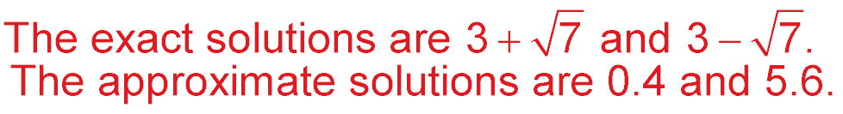
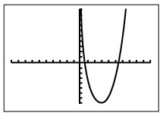
Example 3
Irrational Roots
Answer:
Check Check these results by graphing the related quadratic function, y = x² – 6x + 2. Using the ZERO function of a graphing calculator, the approximate zeros of the related function are 0.4 and 5.6.
[–10, 10] scl: 1 by [–10, 10] scl: 1

Slide 15
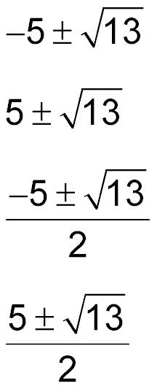
Example 3
Solve x² – 5x + 3 = 0 by using the Quadratic Formula.
A.
B.
C.
D.
A
B
C
D

Slide 16
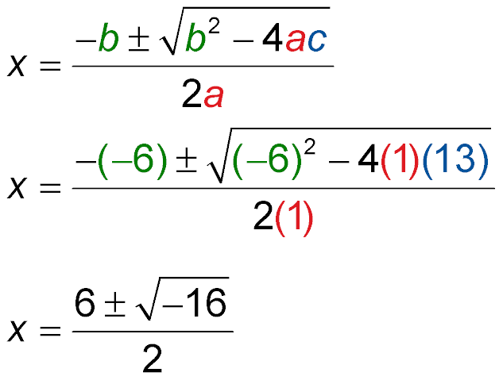
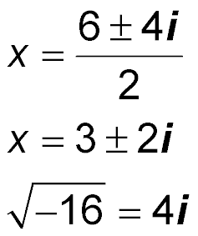
Example 4
Complex Roots
Solve x² + 13 = 6x by using the Quadratic Formula.
Quadratic Formula
Replace a with 1, b with –6, and c with 13.
Simplify.
Simplify.

Slide 17
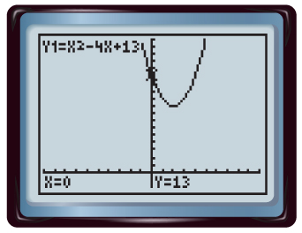
Example 4
Complex Roots
Answer: The solutions are the complex numbers 3 + 2i and 3 – 2i.
A graph of the related function shows that the solutions are complex, but it cannot help you find them.
[–5, 15] scl: 1 by [–5, 15] scl: 1

Slide 18
Example 4
Complex Roots
Check To check complex solutions, you must substitute them into the original equation.
The check for 3 + 2i is shown below.
x² + 13 = 6x Original equation
?
(3 + 2i)² + 13 = 6(3 + 2i) x = (3 + 2i)
?
9 + 12i + 4i² + 13 = 18 + 12i Square of a sum; Distributive Property
?
22 + 12i – 4 = 18 + 12i Simplify.
18 + 12i = 18 + 12i
✓

Slide 19
Example 4
Solve x² + 5 = 4x by using the Quadratic Formula.
A. 2 ± i
B. –2 ± i
C. 2 + 2i
D. –2 ± 2i
A
B
C
D

Slide 20
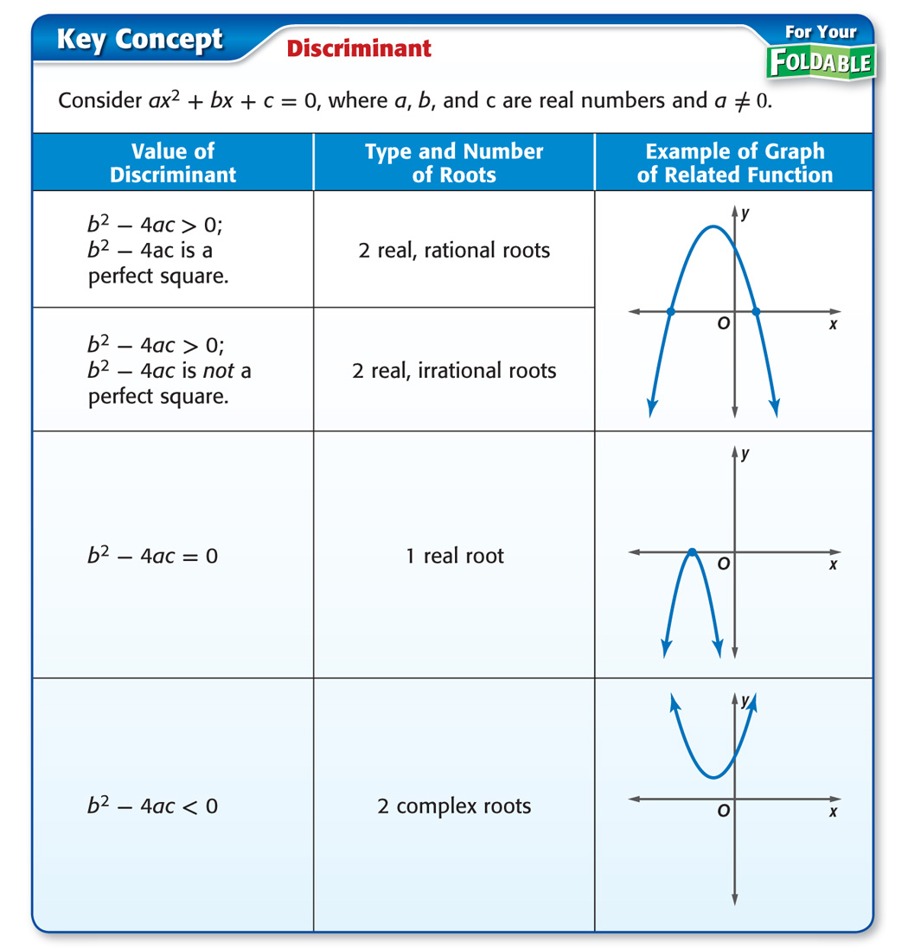
Concept

Slide 21
Example 5
Describe Roots
A. Find the value of the discriminant for
x² + 3x + 5 = 0. Then describe the number and type of roots for the equation.
a = 1, b = 3, c = 5
b² – 4ac = (3)² – 4(1)(5) Substitution
= 9 – 20 Simplify.
= –11 Subtract.
Answer: The discriminant is negative, so there are two complex roots.

Slide 22
Example 5
Describe Roots
B. Find the value of the discriminant for
x² – 11x + 10 = 0. Then describe the number
and type of roots for the equation.
a = 1, b = –11, c = 10
b² – 4ac = (–11)² – 4(1)(10) Substitution
= 121 – 40 Simplify.
= 81 Subtract.
Answer: The discriminant is 81, so there are two rational roots.

Slide 23
Example 5
A. Find the value of the discriminant for
x² + 8x + 16 = 0. Describe the number and
type of roots for the equation.
A. 0; 1 rational root
B. 16; 2 rational roots
C. 32; 2 irrational roots
D. –64; 2 complex roots
A
B
C
D

Slide 24
Example 5
B. Find the value of the discriminant for
x² + 2x + 7 = 0. Describe the number and
type of roots for the equation.
A. 0; 1 rational root
B. 36; 2 rational roots
C. 32; 2 irrational roots
D. –24; 2 complex roots
A
B
C
D

Slide 25
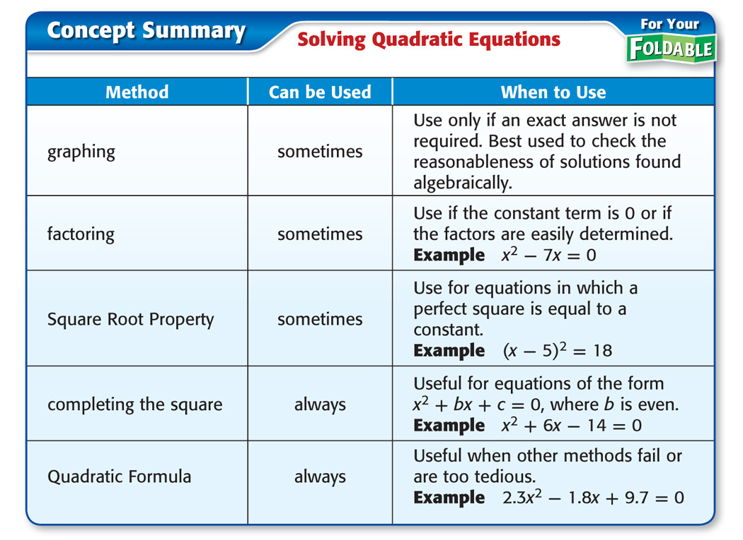
Concept

Slide 26
End of the Lesson

